Slide 1
Observation to Inquiry
Engaging Our Local Surroundings using Images

Slide 2
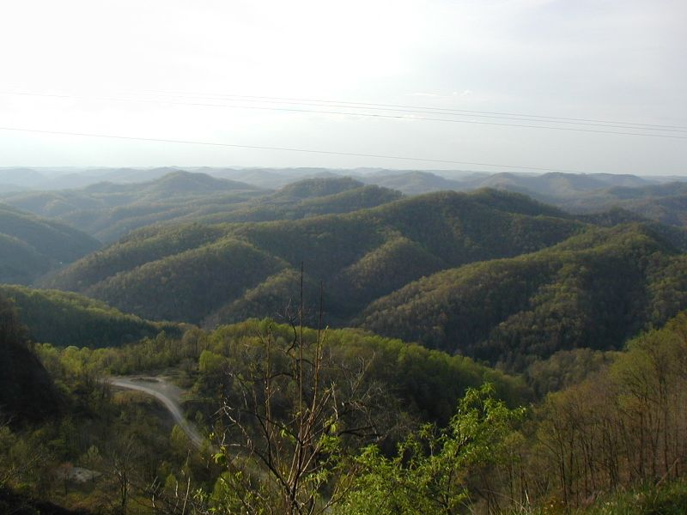
Appalachian Mountains

Slide 3
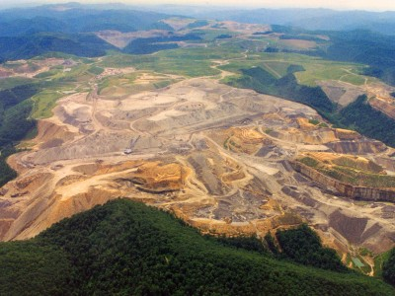
Reece’s Argument

Slide 4
Freewriting Observation:
Freewriting Observation: As we click through these photo sequences, describe what you see in detail and provide any initial insight or reaction to these images.

Slide 6
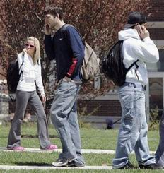

Slide 8
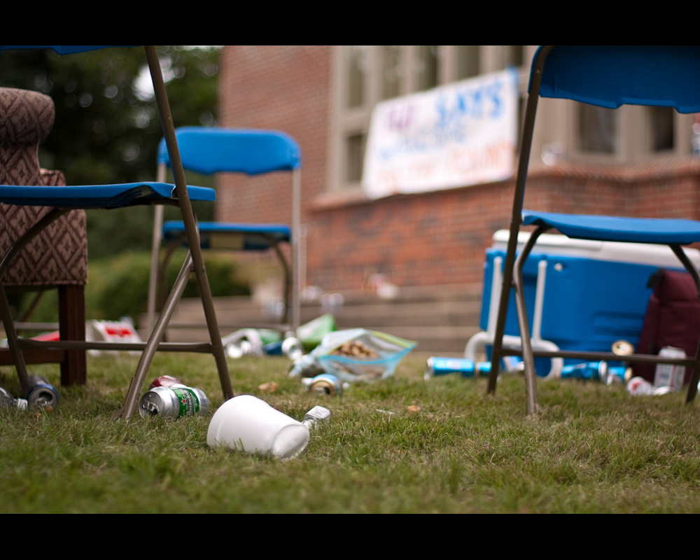

Slide 9
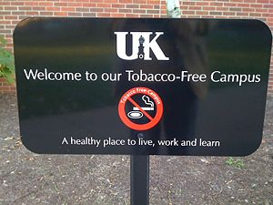

Slide 10
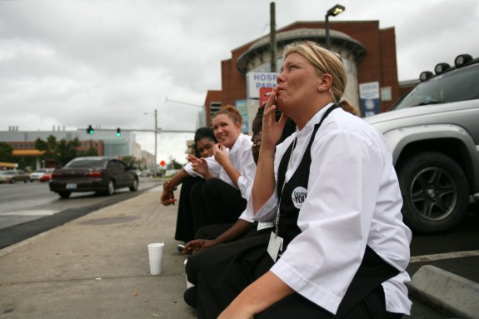

Slide 11
Freewriting Critical Inquiry:
Now let’s click through these images a second time and look deeper into their significance. Using this same freewriting technique, provide more critical inquiry into these photos using the following questions:
*What issues/problems are being related ? *What arguments are being made?
*What questions can be drawn from these photos?
**Provide some possible captions for these images

Slide 18
The Power of Images and Text: Moving into an Argument
Finally, let’s see how our interpretation of these images is affected by adding simple captions.

Slide 19
Promotional Photo:
Can True Diversity Be Contrived?

Slide 20
How Connected are We?

Slide 21
School Pride

Slide 22
Campus Pride

Slide 23
Tobacco-Free?

Slide 24
Free Tobacco

